Slide 1

Optimising Trading Strategies Based on Technical Analysis
COMP6560 Assignment
By Corinne Batho-Newton (cb830)

Slide 2
Implementation Achieved
Part A: Implementing technical indicators and trading signals ✓
The original dataset was manipulated, technical indictors successfully added, and trading signals generated using R studio.
Task 1: Technical Indicators (10%) ✓
Task 2: Trading Signals (10%) ✓
Part B: Genetic Algorithm ✓
Task 1 (40%)
Individual representation ✓
Fitness function ✓
Selection method ✓
Genetic operators ✓
Termination criteria ✓
Task 2 (20%) ✗
Modification: some aspects were implemented but commented out due to functionality within the fitness function not being achieved.
Notes:
Most aspects of the GA were implemented, however, I ran into issues when implementing task 2 of the genetic algorithm. After initially attempting to a gene representing the amount to be traded in terms of stock, by genetic algorithm started to return some negative cash balance values for the best fitness. I failed to debug this before submission, and therefore commented out lines where I had started to implement this.

Slide 3
Implementation Broken Down
Difficulties encountered during implementation, what went well, and what has gone wrong.
Notes:
The following slides break down the stages of the implementation, how it was done and what went wrong.

Slide 4
Part A: Implementing technical indicators and trading signals
The technical indicators were all successfully implemented using R Studio. No difficulties were encountered in this process.
Task 1: Technical Indicators
Task 2: Trading Signals
Exponential Moving Average (EMA)
24-Day Break Out Rule (TBR)
29-Day Volatility (VOL)
25-Day Momentum (MOM)
EMA Action
TBR Action
VOL Action
MOM Action
Notes:
The technical indicators were all successfully implemented using R Studio. R Studio was chosen for it’s simplicity for reading and manipulating data files. The completed dataset was saved as a new “Unilever.csv” file, ready to be loaded into java. No difficulties were encountered in this part of the process.

Slide 5
Part B: Genetic Algorithm - Individual Representation
Random values for each individual in the population generate.
Each individual has 4 genes, each holding the weight for each trading signal.
No issues in the implementation of this task.
- Fitness Function
Fitness function starts the simulation of a trading session for the individual being evaluated.
Trading session calculates the strength of each signal (buy, sell, hold).
The signal with the strongest weight is executed (unless hold, in which case do nothing).
The total cash after trading session is returned as the fitness for the given individual.
Notes:
The individual representation and fitness function were implemented effectively, and no issues were encountered.

Slide 6
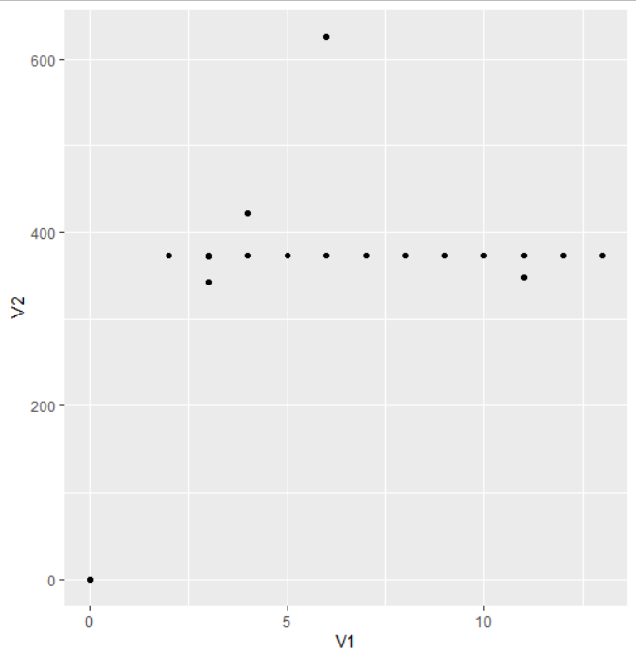
Part B: Genetic Algorithm - Selection Method
GA uses tournament selection to choose parent where K = the side of the tournament.
The size of K was explored to see how it effects the fitness, there was a slight increase in fitness with a K value of 6, so this was chosen. Overall there was little variation.
Elitism was also used to select the best 2 candidates to survive to the next population.
Fitness
K Value

Slide 7
Part A: Genetic Algorithm - Genetic Operators
Mutation
Crossover
Swap Mutation was chosen as the mutation method.
Two genes in the chromosome are randomly chosen, and their values are swapped.
Uniform Crossover was chosen as the crossover method.
The crossover probability is used to determine if a gene in the same index for two parents should swap.
- Termination Criteria
Maximum generation value is set to 300.
Notes:
The genetic operators were implemented successfully. Initially each gene index had a 50% chance of crossover, however this was updated to use the crossover probability value instead.

Slide 8
Task 2: Modification
There was an attempt to modify the GA to include a gene for each individual, that represents the amount of stock to be traded.
However, this caused the fitness value to decrease, with the cash balance being negative in some instance.
Consequently, lines where this was implemented were commented out so better results could be analysed.

Slide 9
Results
Fitness (Balance) | EMA Action | TBR Action | VOL Action | MOM Action
422.68 | 0.761 | 0.034 | 0.761 | 0.761
422.78 | 0.868 | 0.101 | 0.868 | 0.101
373.01 | 0.149 | 0.687 | 0.687 | 0.687
348.7 | 0.786 | 0.283 | 0.283 | 0.786
As can be seen, many values are repeating, suggesting that there is an issue within the mutation and/or crossover methods.

Slide 10
What still needs to be done…
If I was to continue working further on this assignment, the following alterations could be made:
Further investigation of mutation and crossover method to find the error causing repeated weight values.
Analysis of how changing the K value, Population size, max generation and mutation probability effects the fitness, in order to determine optimal values.
Implement different crossover/mutation types and see how the effect the best fitness.

